Slide 1
Computer Programming
JavaScript

Slide 2
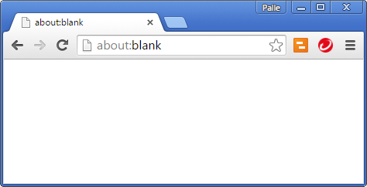
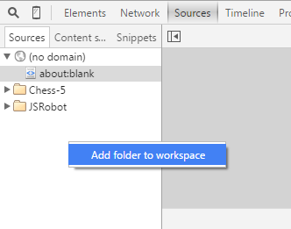
Chrome – Add Folder
F12

Slide 3
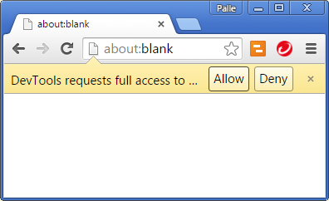
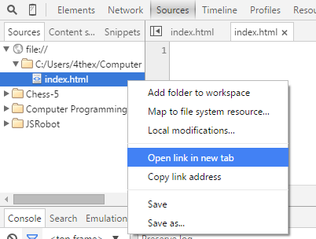
Chrome – Add Folder
Notes:
Add a file named ‘index.html’ in the folder, and it will appear in the ‘Sources’ area.

Slide 4
Web Page – index.html
<html>
<head>
<title>Name of my page</title>
<link rel="stylesheet" type="text/css" href="style.css"/>
<script type="text/javascript" src="main.js"></script>
</head>
<body>
</body>
</html>
Tag name, content, attribute name, attribute value

Slide 5
JavaScript Variables
var name = "Palle";
var age;
age = 47;
var danish = true;
var address = [55396, "Big River Dr.", "Bend", "OR", 97707];
or
var address = {
house: 55396, street: "Big River Dr.", city: "Bend",
state: "OR", zipcode: "97707"
};
var house = address.house;
String, Number, Boolean, Array, Object

Slide 6
+ operator
var sum = 1 + 2 + 3;
sum;
6
"The sum is " + sum;
The sum is 6

Slide 7
Functions
var add = function(a, b) {
return a+b;
};
var sum = add(5, 10);
sum;
15

Slide 8
Methods
var summer = {
add: function(a, b) {
return a+b;
}
};
summer.add(5, 10);
15

Slide 9
Function as argument
var executor = function(action, a, b) {
return action(a, b);
};
var add = function(a, b) {
return a+b;
};
executor(add, 5, 10);
15

Slide 10
Function as result
var summer = function(a) {
var b = 0;
var add = function() {
b += a;
return b;
};
return add;
};
var fiver = summer(5);
fiver();
5
fiver();
10

Slide 11
Condition
var sum = 1 + 2 + 3;
if(sum > 5) {
sum = 2;
}
sum;
2

Slide 12
Truthry conditions
5 == "5"
0 == false
1 == true
"true" != true
"0" == false
"1" == true
"word"
5

Slide 13
Truly true
5 === 5
"5" !== 5
true
!false
"word" === "word"
5 > 4
typeof("word") === "string"

Slide 14

String
"word".length;
4
"word".indexOf("or");
1
"word".slice(1, 3);
or
"1,2,3,4".split(",");
["1", "2", "3", "4"]

Slide 15

Number
5.toString();
"5"
5.2534.toFixed(2);
"5.25"
parseFloat("5.25");
5.25

Slide 16

Boolean
true.toString();
"true"
false.toString();
"false"
var falseString = "false";
var falseValue = (falseString === "true");
falseValue;
False

Slide 17
Array

Slide 18
Object

